Slide 1
Tag
Alixander Roden (Group 4)

Slide 2
What is the game?
2D Multiplayer Tag Game
3 Different Types of Items
4 Rounds each introducing a different mechanic
Learn, Practice, Master

Slide 3
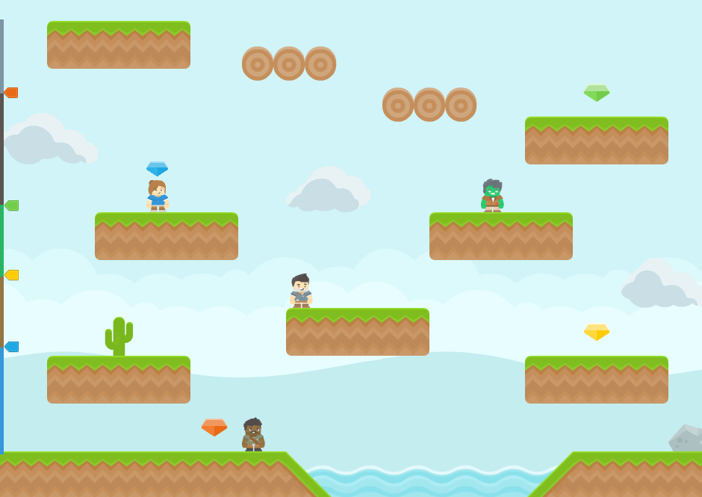
Item
Player carrying item
Player
Scorebar

